Slide 1





BotBuddies Presents Chhatrapati Sambhajinagar’s Biggest Tech Hackathon INNOHACK 2025
Project Name : InsureSmart
Team Name : INFINITY
Team Members : Samyak Dahale, Aditya Salunke, Attadeep Sawale, Ganesh Kondke
Institution: UDICT, MGM University , Chh.Sambhajinagar

Slide 2

Problem Statement
Title: The Gap in Health Insurance Accessibility PS ID: 15 (OPEN)
User searches for plans of Insurers’ portal or 3rd party sites
Applies for the chosen plan (Not purchase directly)
Pays 1st premium amount upfront
Underwriter reviews application
Refund if rejected, but…
Same plans shown for different inputs
Issues faced by Users:
🔒 Capital gets locked
❌ Uncertain approval
🔄 Lack of personalization
🚫 Limited ability to explore
Workflow of buying insurance policy in India

Slide 3



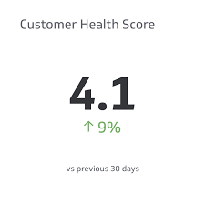


Proposed Solution
Medical Report Upload & Parsing
AI-Powered Health Risk Prediction
Health Score Generation
Personalized Insurance plans
Location Suggestion

Slide 4






Tech Stack
Technologies to be Used:
Frontend = Streamlit framework
Backend = Python scripts
Database System = Firebase
Document Parsing = Tesseract OCR, pdf2image, PIL.
ML Model = Random Forest or Multi-level Perceptron deployed as .pkl file.
Dataset = Dataset named Diagnostic Pathology Test Results (Kaggle) (link)
Deployment = Streamlit Cloud.
Location display = Google Maps API

Slide 5

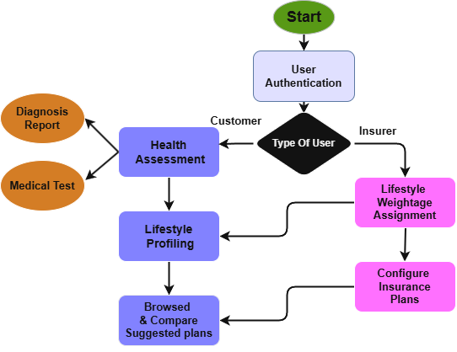
System Architecture / Workflow

Slide 6

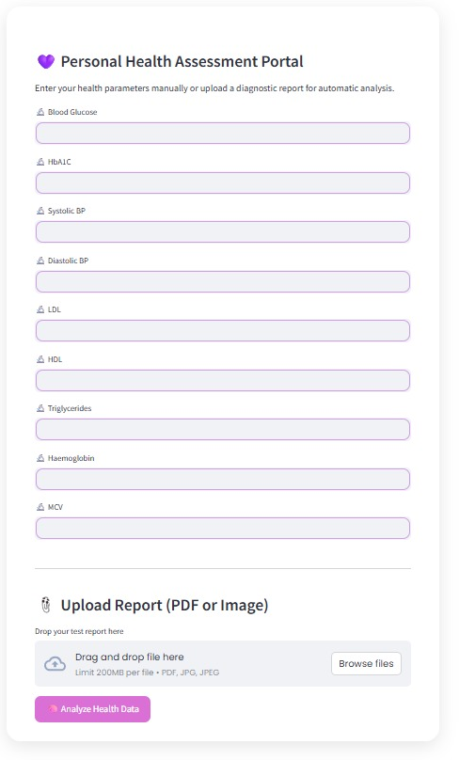
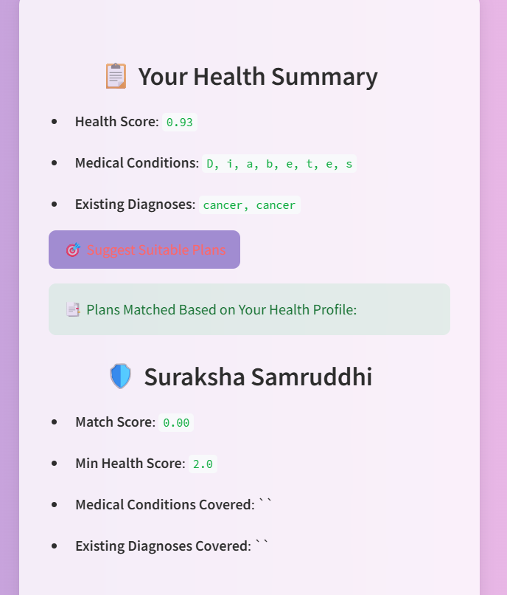
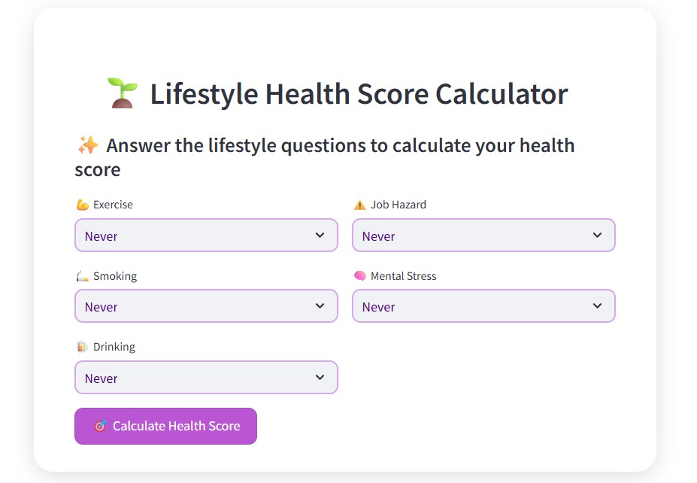
Prototype / Screenshots
GitHub Repo Link: https://github.com/SamyakDahale/INFINITY_Innohack

Slide 7
Innovation & Impact
Simplified Health Insurance Selection
Data driven Insights
Reduced dependence on Agents
Market expansion for Insurers

Slide 8

Team & Roles
Samyak Dahale Role: Firebase Setup & Deployment
Aditya Salunke
Role: ML Model Development & Integration
3. Ganesh Kondke
Role: UI/UX Design & Frontend Support
Attadeep Sawale
Role: Data Analysis & Streamlit App Development

